Slide 1
Flow-of-Control Statements

Slide 2
Syntax-directed definition

Slide 3
B and S have a Synthesized attribute code
Labels for the jumps in B.code and S.code are managed using inherited attributes.
For S associate inherited attribute S.next denoting a label for the instruction immediately after the code for S.
Newlabel()-creates a newlabel each time it is called.

Slide 4
Example: If(B) S1 else S2 A=D+E
Syntax-directed definition
P->S
S.next=L1
B.Code
L3: S1.Code
goto L2
L4: S2.code
L2: assign.code
L1:
S-> S1S2
S1.next=L2
S2.next=L1
B.Code
L3: S1.Code
goto L2
L4: S2.code
L2: assign.code
S->If (B) S1 else S2
B.T=L3
B.F=L4
S1.next=S2.next=L2
B.Code
L3: S1.Code
goto L2
L4: S2.code
S->assign
S.code=assign.code

Slide 5
Generating three-address code for booleans

Slide 6
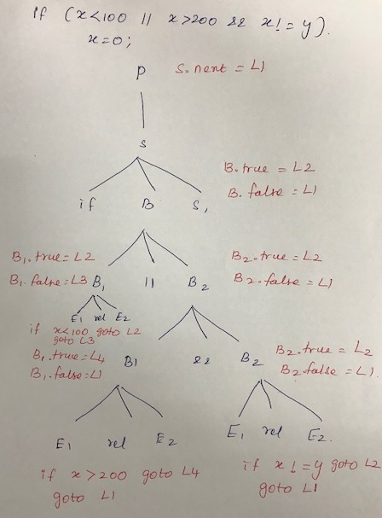
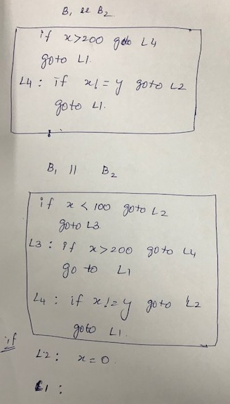

Slide 7
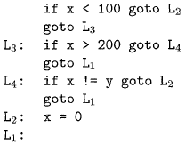
Translation of a simple if-statement

Slide 8
Backpatching

Slide 9
Backpatching
Backpatching is a method to deal with jumps in the control flow constructs like if statements, loops, etc in the intermediate code generation phase of the compiler.
Backpatching is a technique used in compiler design to delay the assignment of addresses to code or data structures until a later stage of the compilation process. This allows the compiler to generate code with placeholder addresses that are later updated or "backpatched" with the correct addresses once they are known. Backpatching is commonly used in compilers for languages that support complex control structures or dynamic memory allocation.
Previous codes for Boolean expressions insert symbolic labels for jumps
It therefore needs a separate pass to set them to appropriate addresses
We can use a technique named backpatching to avoid this
We assume we save instructions into an array and labels will be indices in the array

Slide 10
Backpatching can be used to generate a Boolean expressions program and the flow of control statements in a single pass. In jumping code for Boolean statements, the synthesized properties truelist and falselist of non-terminal B are utilized to handle labels.
B.truelist, which is a list of the jump or conditional jump instructions, should contain the label to which control should move if B is true.
When B is false, B.falselist is a list of instructions that will eventually result in the label to which control will be assigned.

Slide 11
All of the jumps to true and false, as well as the label field, are left blank when the program for B is created. The lists B.truelist and B.falselist include these early leaps.
A list of jumps to the instruction immediately after the code for S is displayed by the synthesized attribute S.nextlist on a statement S, for example. It can generate instructions into an instruction array, with labels acting as indexes.
Three functions are used to change the list of leaps:
Makelist (i): Make a new list with only i, an index into the array of instructions, then return a pointer to the newly produced list with the makelist command.
Merge (p1,p2): Returns a pointer to the concatenated list after concatenating the lists pointed to by p1 and p2.
Backpatch (p, i): For each of the instructions on the record pointed to by p, inserts i like the target label.

Slide 12
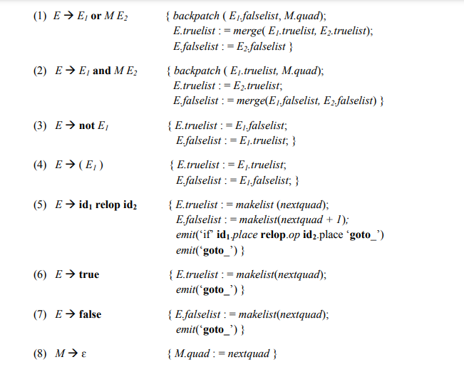
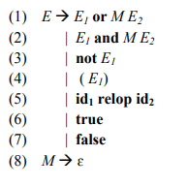

Slide 13
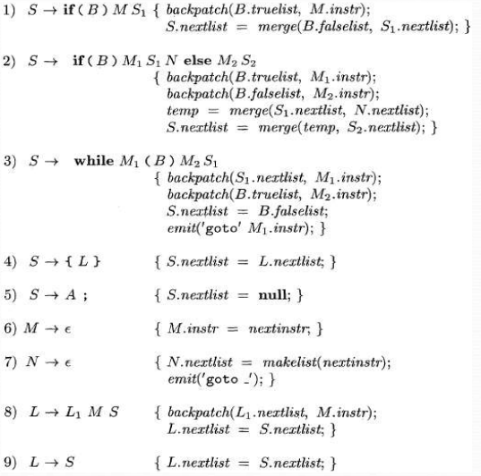
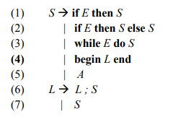

Slide 14
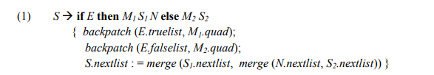
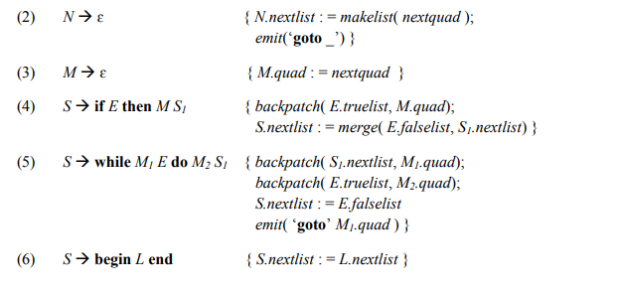
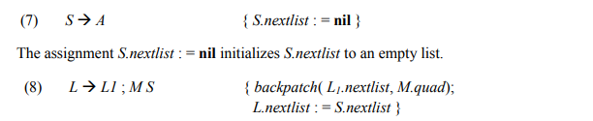

Slide 15
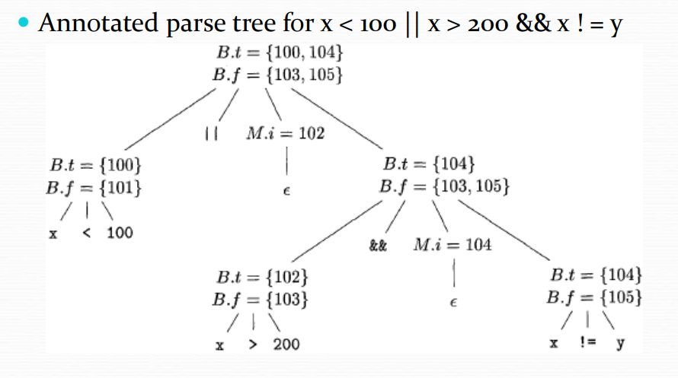

Slide 16
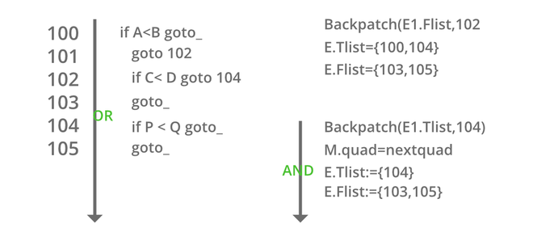

Slide 17
